Slide 1
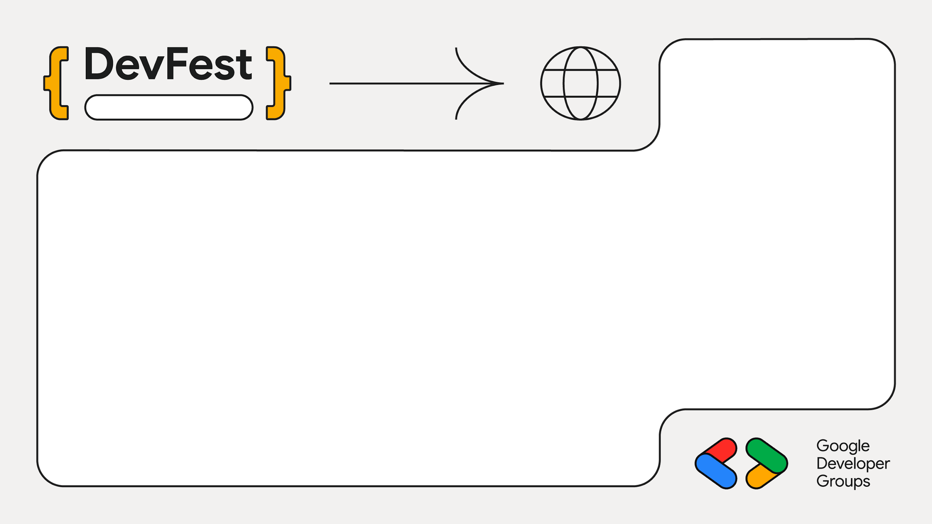
2025
Sarit Center
Migrating android Libraries to Kotlin Multiplatform
Donald Okara
Android Engineer

Slide 2
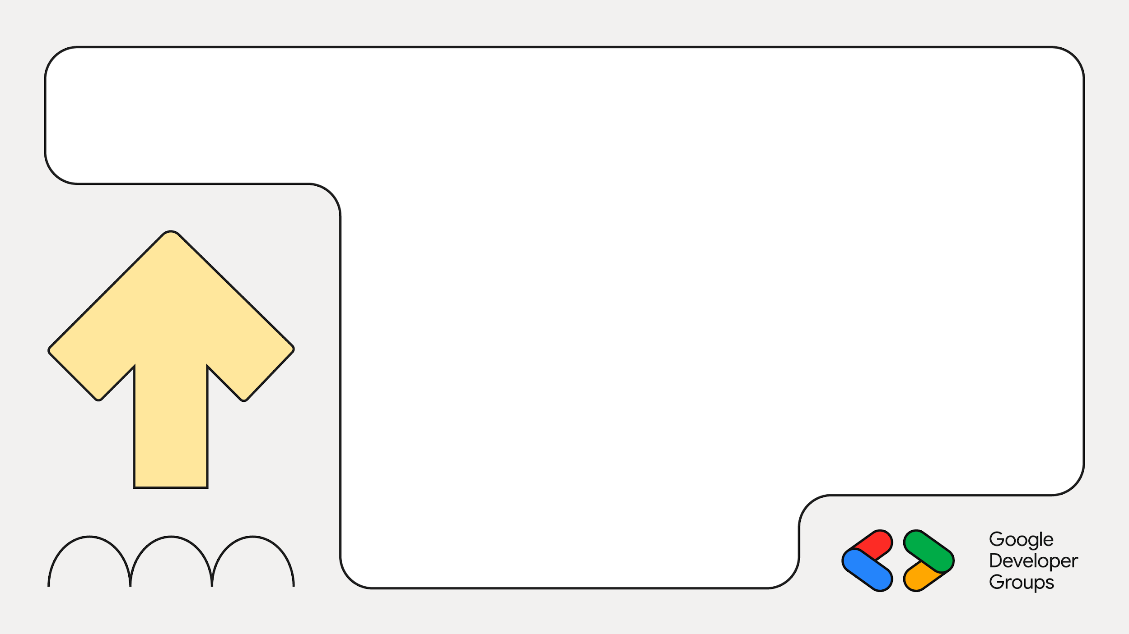
01
Why migrate?
Why is Kotlin Multiplatform the next best move for you app?

Slide 3
02
Anatomy of a Kotlin Multiplatform library

Slide 4

03
Project Repo

Slide 5

04
These are the plugins required for KMP

Slide 6
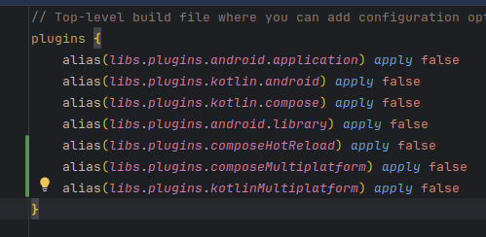
05
Set up configuration options

Slide 7
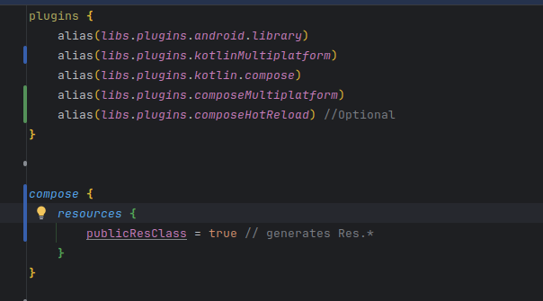
06.a
Apply plugins

Slide 8
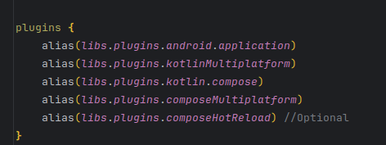
06.b
Apply plugins for application

Slide 9
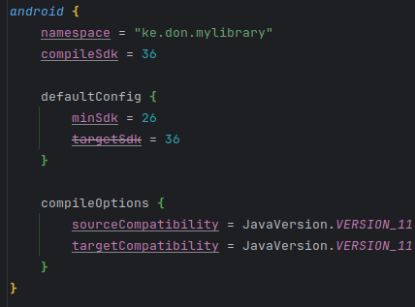
07
Apply plugins

Slide 10

The kotlin block holds the target platforms and dependencies for each

Slide 11
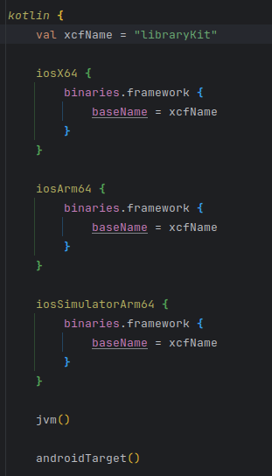
These are the platforms our library will target

Slide 12
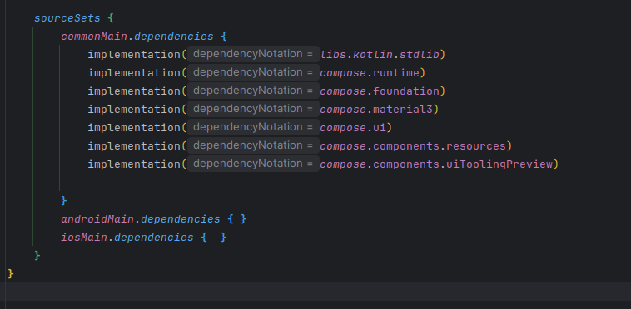
SourceSets are the dependencies our target platforms will use

Slide 13
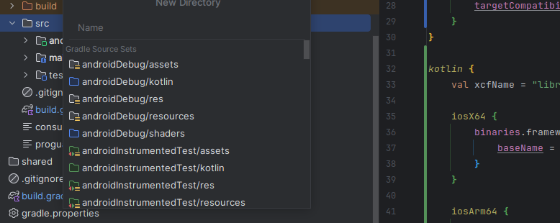
Once gradle builds, move code to commonMain

Slide 14
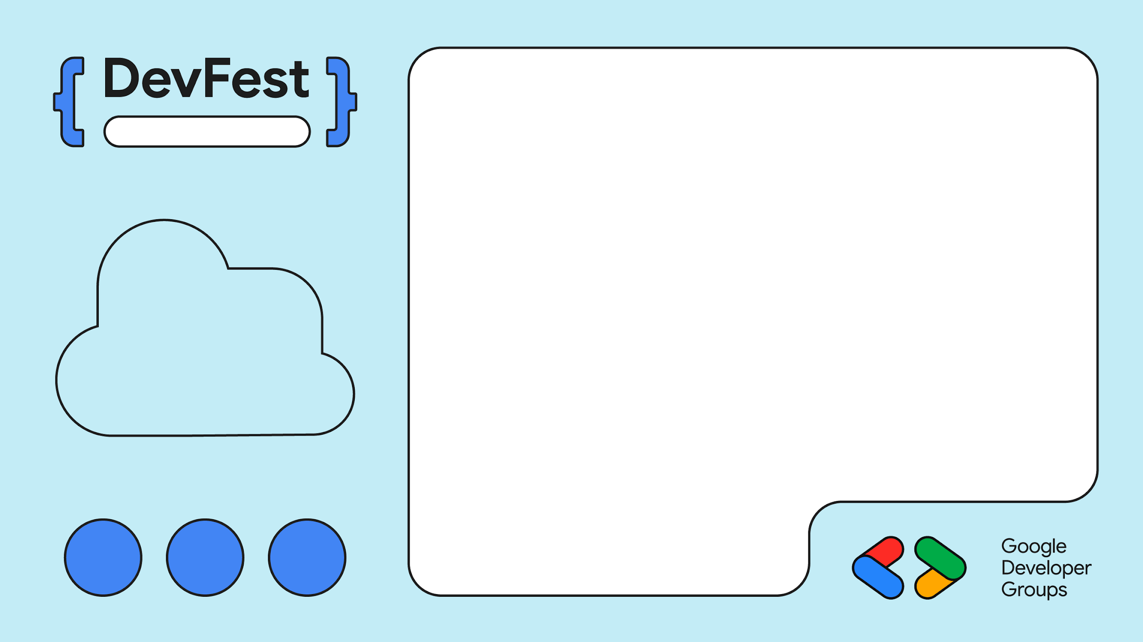
Sarit Center
What goes and what stays

Slide 15
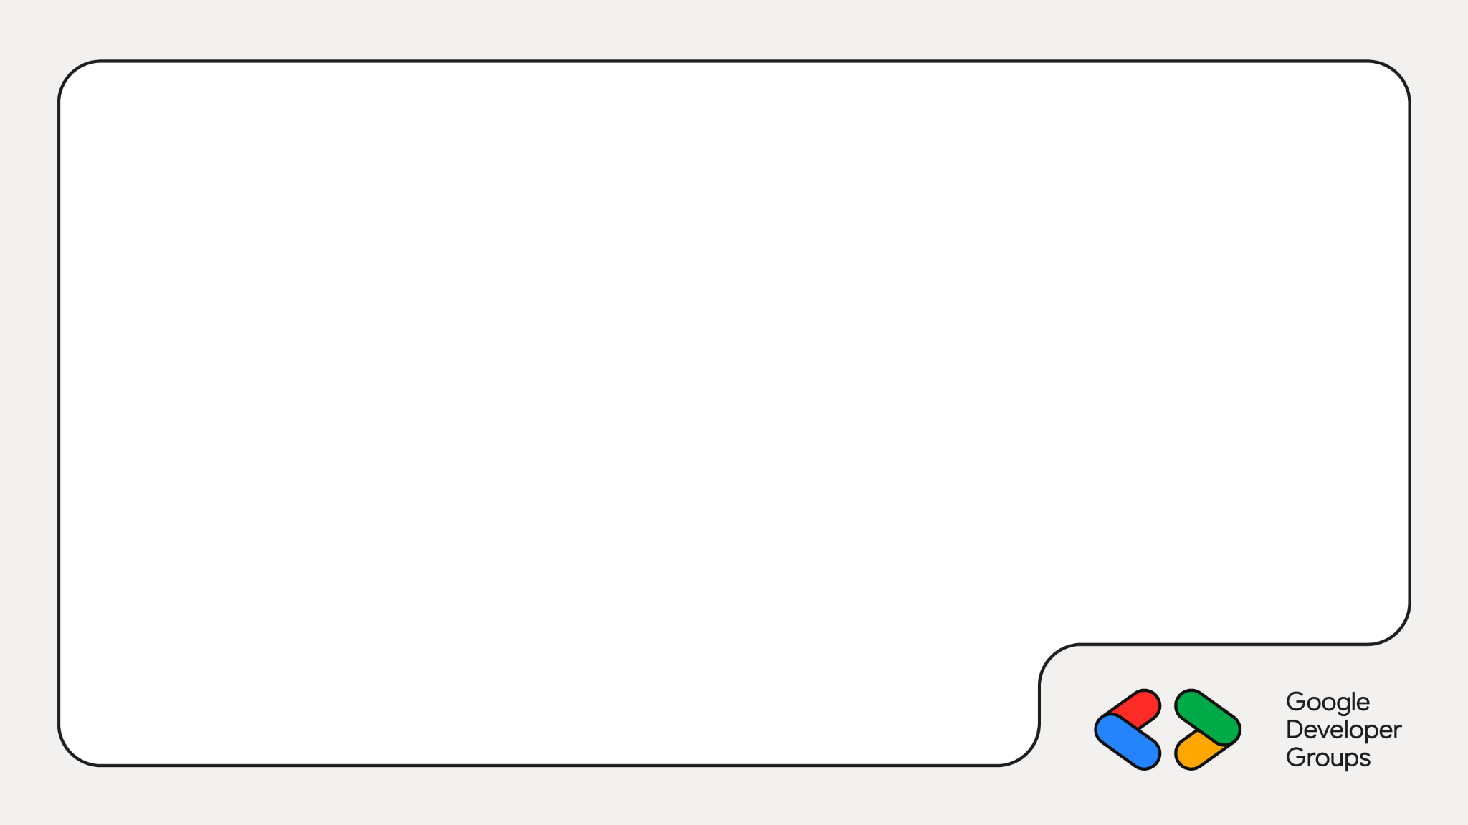
Stays
KMP compatible dependencies
android{} configuration

Slide 16
Goes
The dependencies{} block
Dependencies and plugins not compatible with KMP

Slide 17
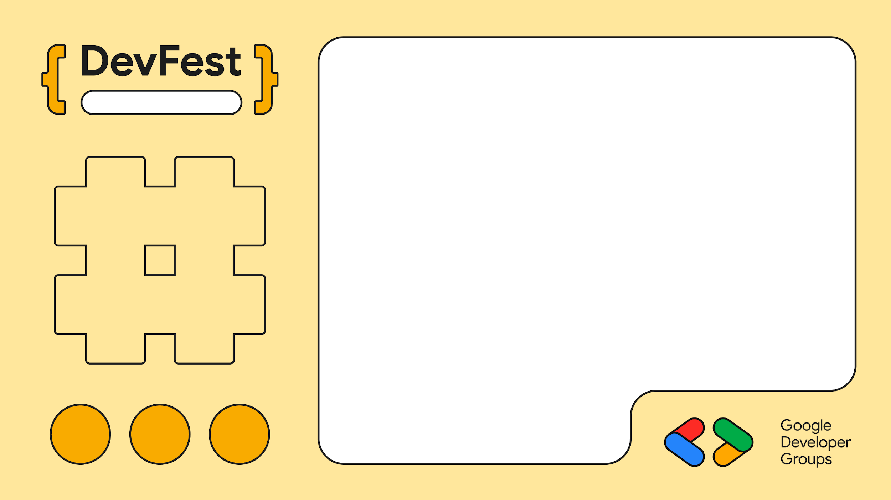
Editable Location
Migration do’s and dont’s

Slide 18
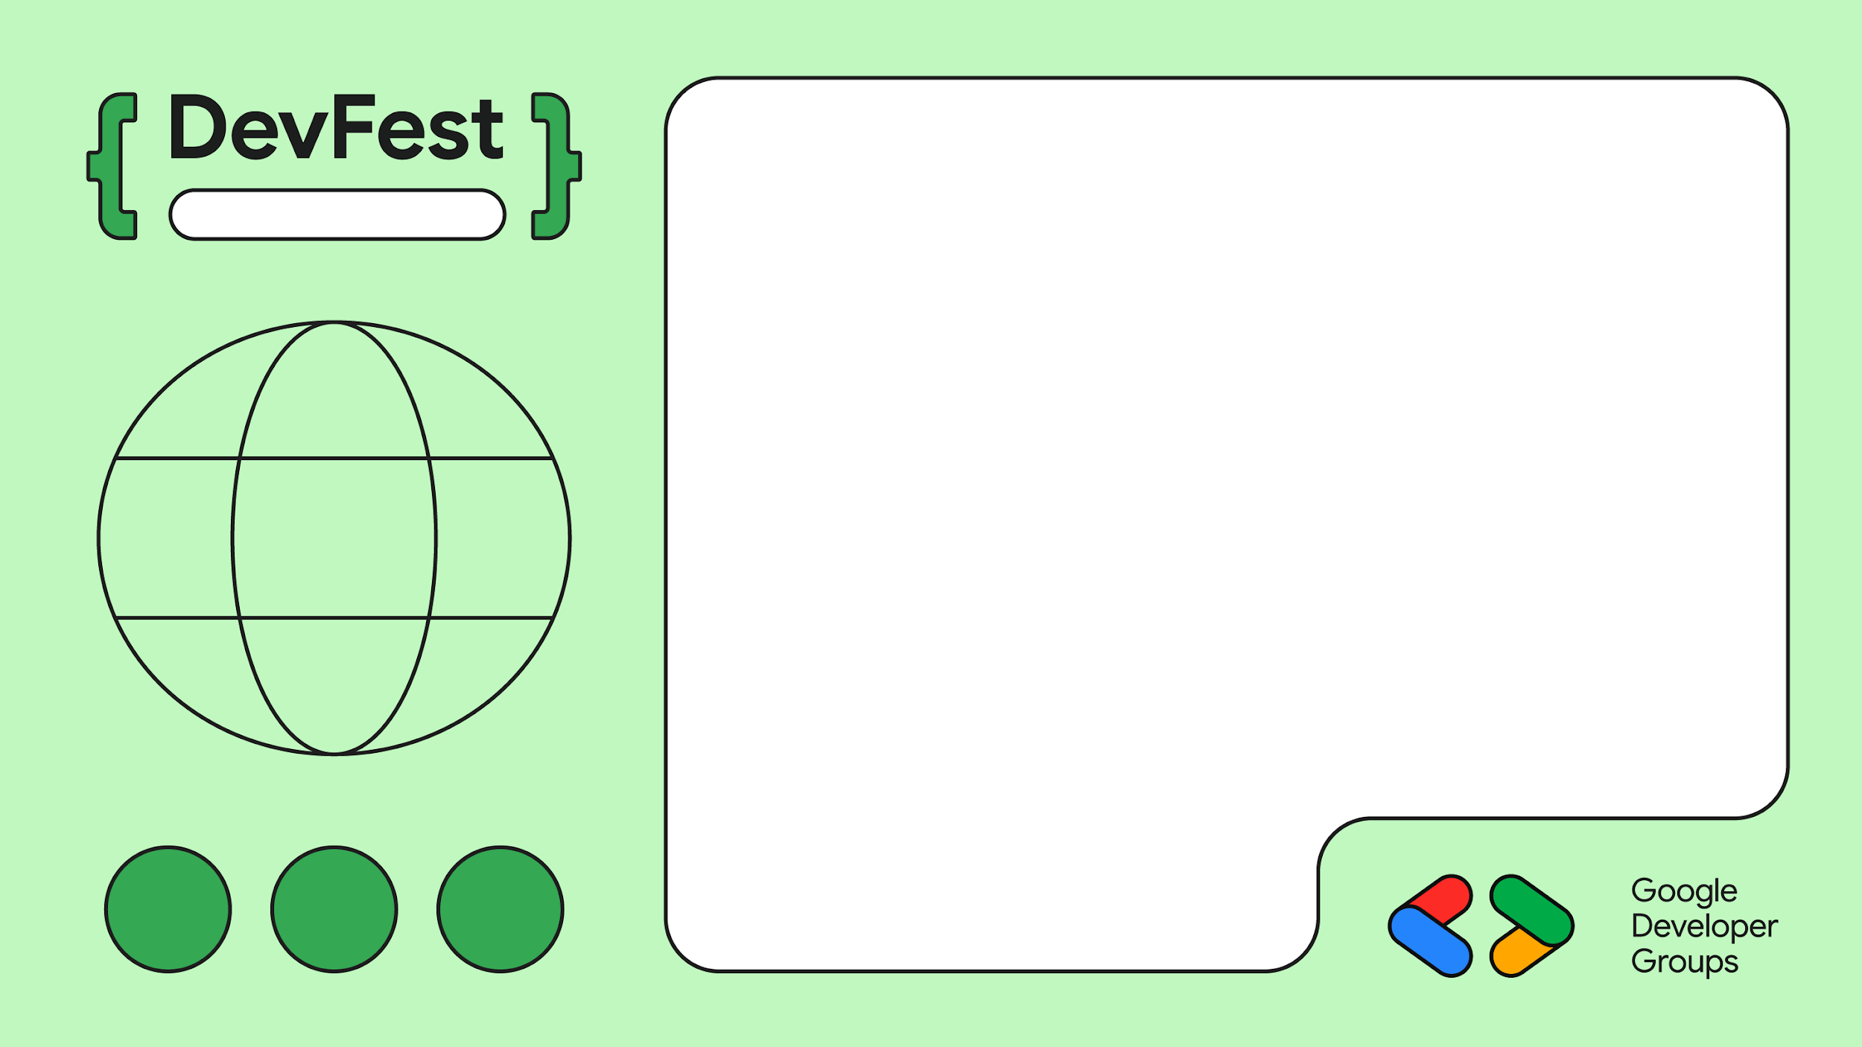
Do’s
Migrate business logic first
Use expect/actual early for platform-specific APIs
Keep your Gradle modular — clarity over cleverness
Test shared code via common tests
Editable Location

Slide 19
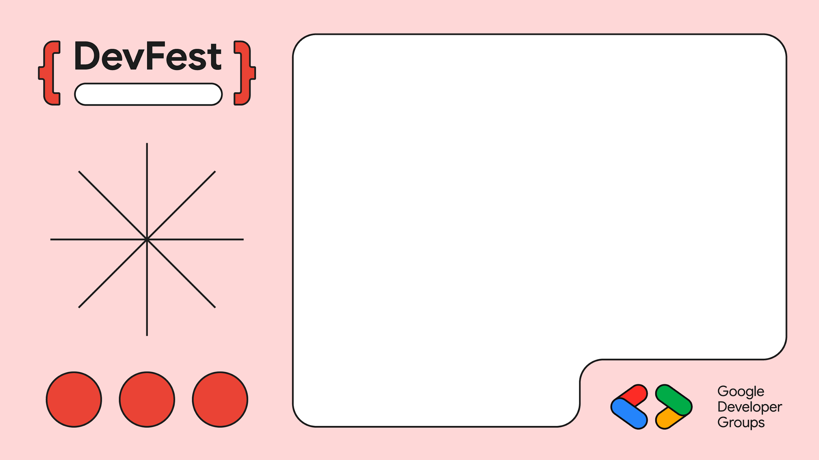
Editable Location
Dont’s
Don’t move UI too early
Don’t mix platform code in shared
Don’t hardcode Android references in commonMain
Don’t skip source set separation
Don’t migrate all at once — ship small

Slide 20
Sarit Center
Q&A

